Slide 1
Aliment Arrange
Presented to: Shakib Mahmud Dipto Sir
Presented By:
Rownak Tasneem Shishir (202014005)
Mitu Akter (201014008)
Zeenat Akter Mim (201014098)

Slide 2
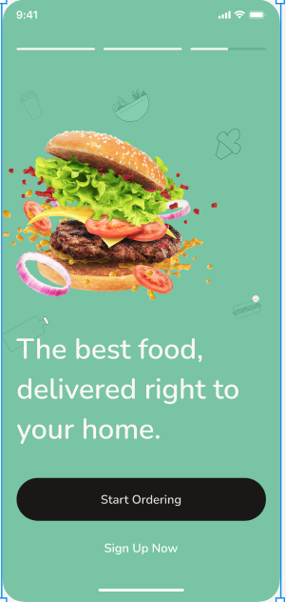
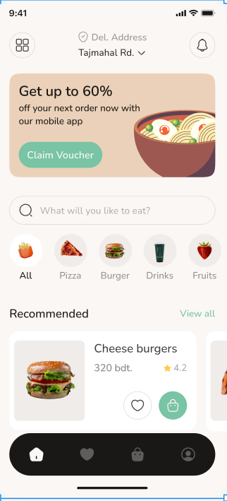
Introduction - Brief overview of the app's purpose and benefits. - Importance of convenience and efficiency in food delivery. **Setting Up Your Account:** - Downloading the app from app stores. - Creating a user profile. - Setting preferences and payment options
.
Browsing Restaurants and Menus: - Exploring nearby restaurants. - Filtering options by cuisine, price, and rating. - Viewing restaurant menus and specials.

Slide 3
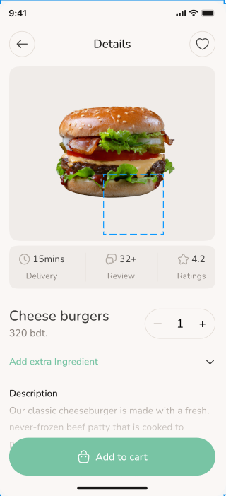
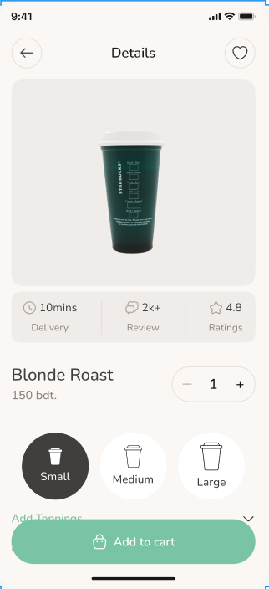
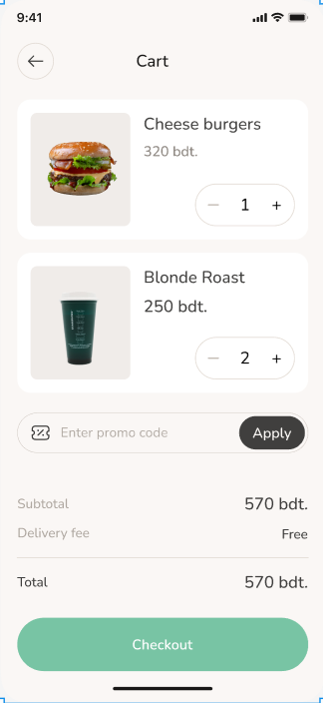
**Placing an Order:** - Selecting items from the menu. - Adding items to the cart. - Reviewing order details. **Customizing Your Order:** - Options for special requests or dietary restrictions. - Adding extra toppings or sides. - Modifying quantities.

Slide 4
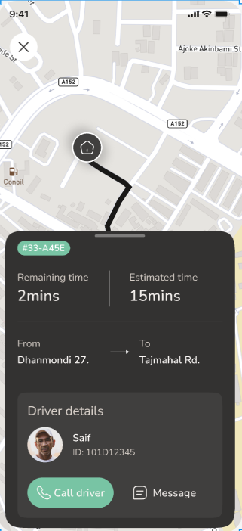
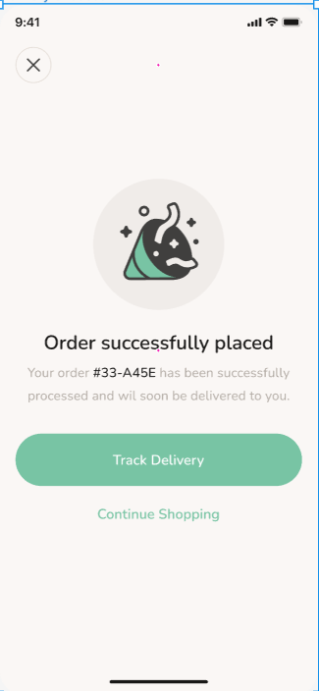
Order success **Managing Your Account:** - Updating personal information. - Viewing order history. - Managing payment methods.
**Tracking Your Delivery:** - Real-time order tracking. - Estimated delivery times. - Communicating with the delivery driver.

Slide 5
THANK YOU

